Slide 1




HOPE TO SKILL
Lecture 31
Variational
Autoencoder(VAE)
Artificial Intelligence Advance Course

Slide 2



Dedicated to my late Teacher, a beacon of Knowledge.
Your Guidance shaped me; now I shape others through
a free course.
YOUR LEGACY LIVES ON!

Slide 3




AI INSTRUCTORS
Dr.Irfan Malik
Dr.Sheraz Naseer
Dr.Shazia Saqib
M.Haris Tariq

Slide 4



Previous Lecture Topics
01
Types of Autoencoders
02
Vanilla Autoencoder
03
Denoising Autoencoder
04
Convolutional Autoencoder
05
Variational Autoencoder

Slide 5
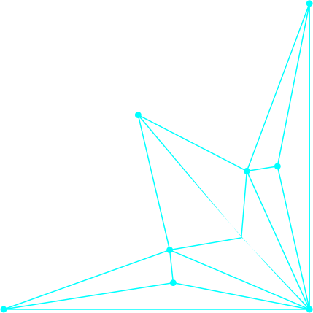
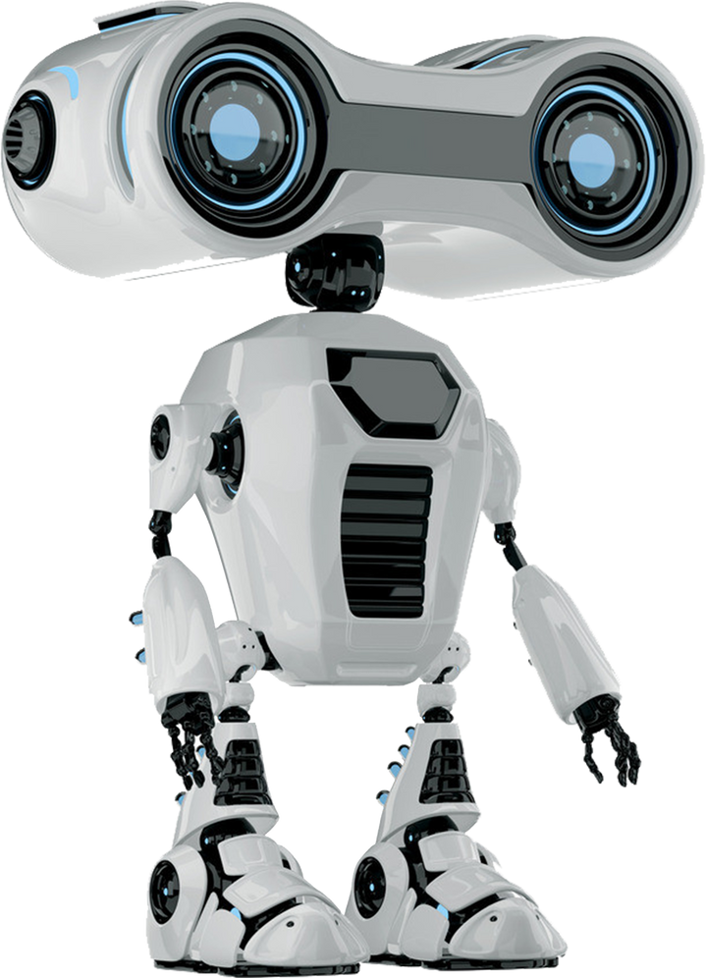

Outline
Autoencoders
Limitations of Traditional Autoencoders
Variational Autoencoder (VAE)
Practical Implementations

Slide 6
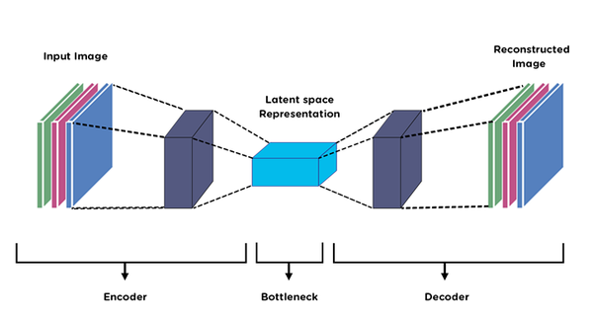



Limitations of Traditional Autoencders
Poor Generative Capabilities:
Limited ability to generate new data
Deterministic Nature: No control
over the distribution of latent space

Slide 7
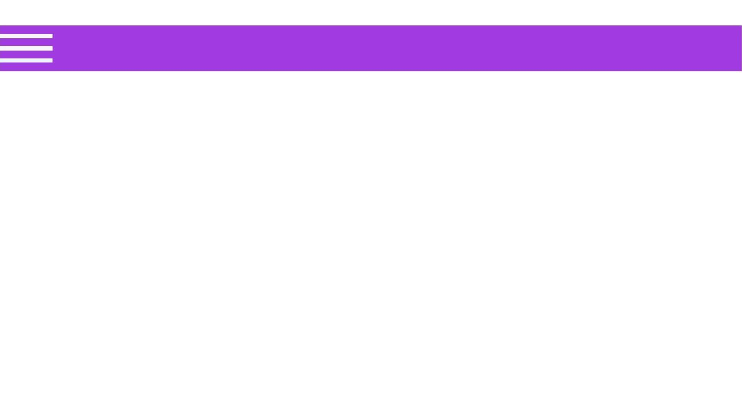
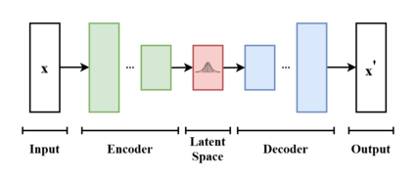
Variational Autoencoder (VAE)
What are Variational Autoencoders?
VAEs are probabilistic graphical models that encode data into a probabilistic latent space.
A major issue with regular Auto encoders is that the latent space that the inputs are converted to are discrete (not continuous) and does not allow for an easy interpolation.
Key Components: Encoder, Latent Space (with mean and variance), Decoder

Slide 8



Smooth Latent Space: Better
Interpolation and Representation
Advantages of
Variational
Autoencoders
Generative Capabilities: Ability to Generate New, Diverse Samples
Regularization: Improved
Generalization of the Model

Slide 9
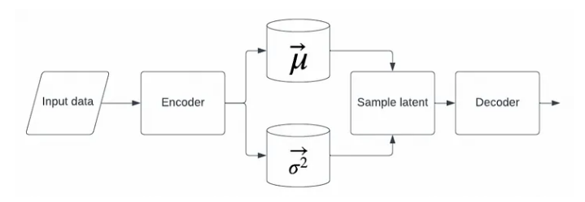
Variational Autoencoder (VAE)
Advantages of Variational Autoencoders
Smooth Latent Space: Better Interpolation and Representation
In VAEs, the latent space is designed to be continuous and smooth, allowing for meaningful interpolation between points in the latent space.
A major issue with regular Auto encoders is that the latent space that the inputs are converted to are discrete (not continuous) and does not allow for an easy interpolation.

Slide 10
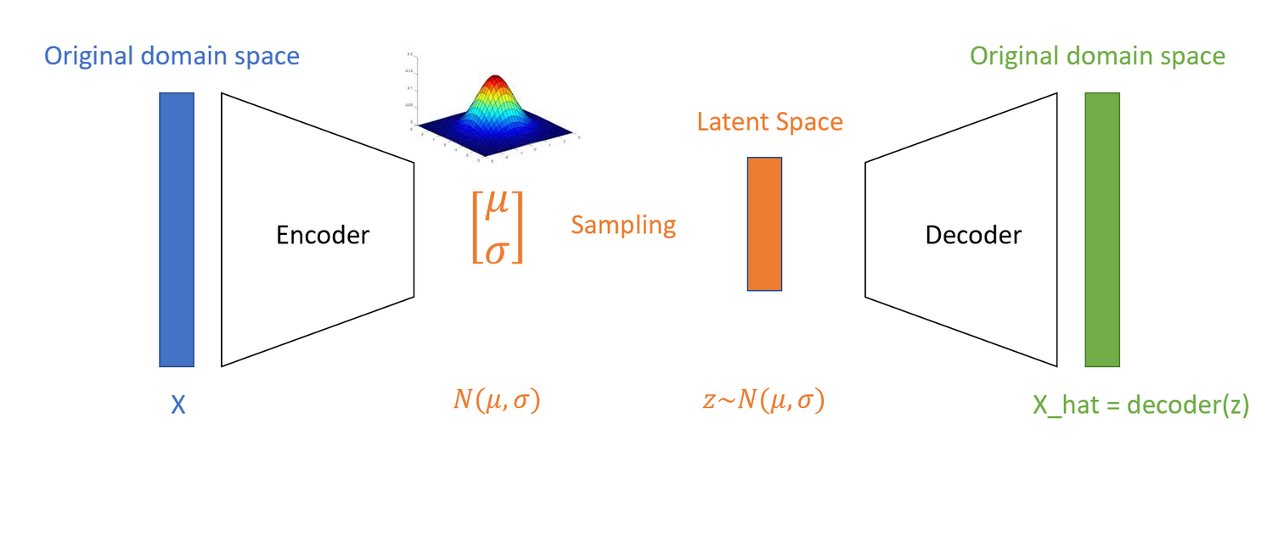
Variational Autoencoder (VAE)
Generative Capabilities
VAEs are powerful generative models that can create new data samples similar to those in the training set.
A major issue with regular Auto encoders is that the latent space that the inputs are converted to are discrete (not continuous) and does not allow for an easy interpolation.
Explanation: By sampling from the latent space distribution and passing these samples through the decoder, VAEs can generate new data points that are diverse and realistic.

Slide 11

Variational Autoencoder (VAE)
Benefits
A major issue with regular Auto encoders is that the latent space that the inputs are converted to are discrete (not continuous) and does not allow for an easy interpolation.
Data Augmentation: Enhancing training datasets with synthetic data, which can improve the performance of other machine earning models.

Slide 12

Variational Autoencoder (VAE)
Benefits
A major issue with regular Auto encoders is that the latent space that the inputs are converted to are discrete (not continuous) and does not allow for an easy interpolation.
Improved Generalization: Models trained with VAEs tend to perform better on unseen data, as the capture more general patterns and are less likely to overfit the training data.
Robust Representations: The regularization helps in learning robust latent representations that are useful for downstream tasks such as classification and clustering.

Slide 13
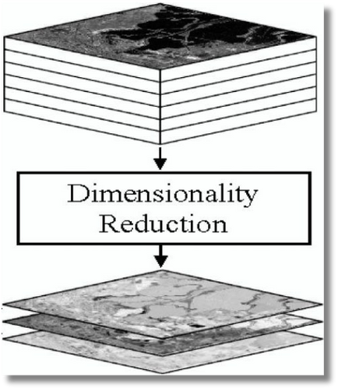

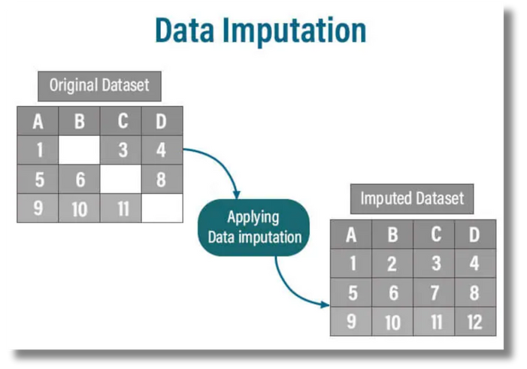
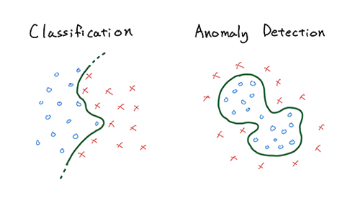
Variational Autoencoder (VAE)
Applications of VAEs
A major issue with regular Auto encoders is that the latent space that the inputs are converted to are discrete (not continuous) and does not allow for an easy interpolation.
Image
Generation
Dimensionality
Reduction
Data
Imputation
Anomaly
Detection

Slide 14


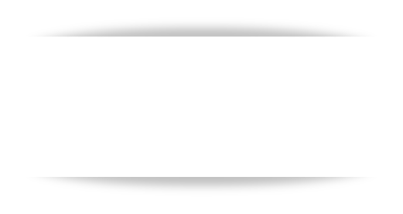
Case studies where VAEs have been
successfully applied:
Case Study 1:
VAE in Medical Image Analysis
Case Study 2:
VAE for Anomaly Detection in Network Security
Case Study 3:
VAE for Data Imputation in Finance

Slide 15


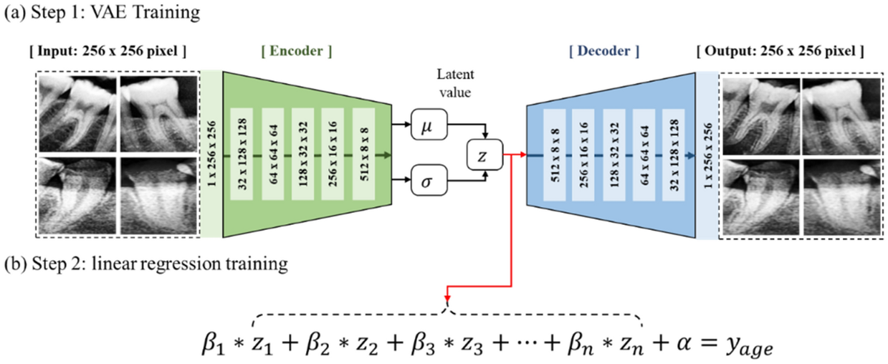
VAE in Medical Image Analysis
Real-world Example:
Variational Autoencoders have been used to improve the analysis of medical images, particularly in detecting anomalies in MRI scans. By training a VAE on a large dataset of healthy MRI images, the model learns to represent the typical structure of these images. When presented with new scans, the VAE can highlight areas that deviate from the norm, potentially indicating the presence of tumors or other abnormalities.

Slide 16
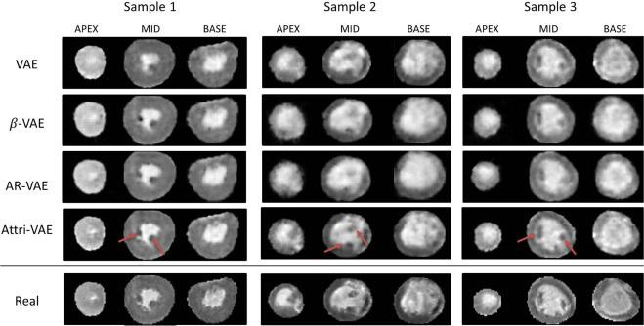
Outcome: The VAE successfully identified anomalous regions in MRI scans that were indicative of tumors.
Improvements Achieved: Increased accuracy in early detection of tumors, leading to better patient outcomes. The model also reduced the false positive rate compared to traditional methods.

Slide 17


Case Study
Real-world Example
VAE for Anomaly Detection in Network Security
Real-World Example
In the field of network security, VAEs have been employed to detect unusual patterns of activity that could indicate a cyber attack. By training on normal network traffic data, the VAE learns to reconstruct typical traffic patterns. Deviations from these patterns, identified by high reconstruction errors, suggest potential security breaches.

Slide 18

Results:
Real-world Example
Outcome: The VAE detected several instances of anomalous traffic that were indicative of security threats, such as DDoS attacks and data exfiltration attempts.
Improvements Achieved: Improvements Achieved: Enhanced ability to detect and respond to security threats in real-time, reducing the impact of potential breaches.

Slide 19



Real-World Example
Case Study
Financial institutions often deal with incomplete datasets, which can hinder accurate analysis and decision-making.
VAEs have been applied to impute missing values in financial records by learning the underlying structure of the data.
This allows for more accurate and complete datasets, improving financial modeling and forecasting.
VAE in Financial Data
Imputation

Slide 20

Results:
Outcome: The VAE accurately imputed
missing values in historical financial datasets,
leading to more reliable models for forecasting
and risk assessment.
Improvements Achieved: Significant reduction
in data imputation errors compared to traditional
methods. Enhanced accuracy in financial
predictions and risk assessments.

Slide 21
Quiz

Slide 22


Conclusion
Key Points:
Recap of what has
been covered
Future Directions:
Emerging trends and
future potential of VAEs
Q&A:
Invite questions
from the audience

